Slide 1

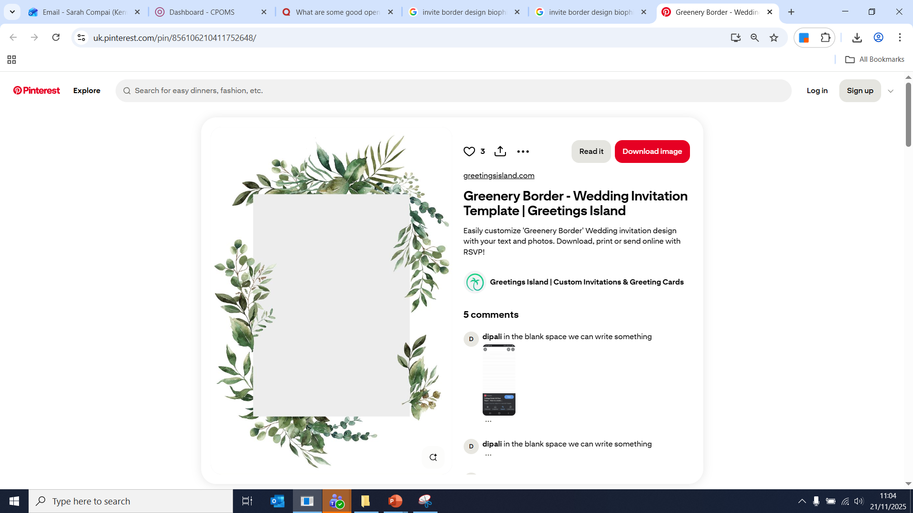

Term 2 Learning Objectives
January to Easter
Community and Outdoor Education
To be respectful to our local environment
To be able to interact with members of the public appropriately
To create purposeful objects using natural materials
Understanding eco-friendly principles and ways of life
Understand and engage with the NHS 5 Ways to Wellbeing, specifically focussing on give, showing an understanding that ‘Research suggests that acts of giving and kindness can help improve your mental wellbeing’ (https://www.nhs.uk/mental-health/self-help/guides-tools-and-activities/five-steps-to-mental-wellbeing/)
Know and give examples to show that giving can create positive feelings and a sense of reward; give you a feeling of purpose and self-worth and help you connect with other people
To be aware of NOLA principles and explain what they mean
All subject specific learning objectives are underpinned by our cross curricular root concepts:

